Slide 1
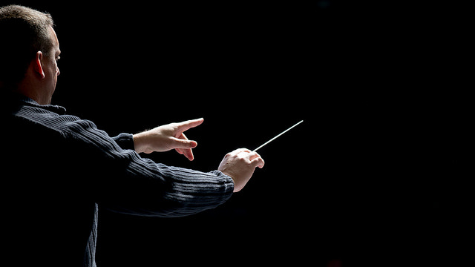
Junior Cycle Music
Students begin their musical journey in first year with a broad introduction to the key skills of performance, composition and music appreciation. The course is guided by 36 learning outcomes as set out in the new Junior Cycle music specification. Learning outcomes are statements that describe what knowledge, understanding, skills and values students should be able to demonstrate having studied music in junior cycle.
•
In second and third year the students build on their foundational knowledge by exploring the 36 outcomes in greater detail. The specification stresses that the learning outcomes are for three years and therefore the learning outcomes focused on at a point in time will not have been ‘completed’ but will continue to support the students’ learning in music up to the end of junior cycle.
Detailed list of learning outcomes
•
Aim
This music specification aims to contribute to the development of artistic awareness and understanding, self-expression, self-esteem, imagination and multicultural sensitivity, and therefore, to the development of the whole person. Students will develop the knowledge, skills and understanding necessary to produce and engage with authentic and original music, that is both theirs and the music of others. In doing so, they will develop the music literacy, critical skills and language necessary to engage with today’s musical world.
Overview
The specification for Junior Cycle Music focuses on giving students the opportunity to develop their musical knowledge, skills and cultural awareness through the practical and cognitive engagement with music. This can be achieved through the three interconnected strands: Procedural knowledge, Innovate and ideate and Culture and context. A student will experience learning in each of these three strands as they progress through their junior cycle.
This Photo by Unknown author is licensed under CC BY.

Slide 2
First Year
Practical musicianship (monthly)
All students come together to perform music in a fun, supportive setting (this can be individual or as part of a group). This provides essential performing opportunities that will help develop key skills as a musician.
•
Routine class assessments
As the students explore the exciting new specification for music, they are given regular opportunities to reflect and appraise their progress on an ongoing basis.
•
In-house exams
Toward the end of each term in-house exams take place offering the students an opportunity to consolidate the work to date.
Second Year
In addition to the assessment procedures of first year, the students will complete the first-of-two classroom based assesments (CBAs).
CBA 1 – Composition portfolio
This Classroom-Based Assessment offers students an opportunity to celebrate their achievements as creators of music artefacts, by compiling a collection of their musical ideas and creative expressions in a variety of genres and styles over time.
Through this process students will develop their musical voice and their identity. When composing music for their chosen audience, students will learn how to bring an idea from concept to realisation.
Third Year
In addition to the assessment procedures of first year, the students will sit a pre-mock and mock exam, complete a second CBA and perform for their Junior Cycle practical examination.
In-house exams
In preparation for the Junior Cycle examinations in June, all students will complete a pre-mock exam (October) and mock exam (February). Both exams offer the student an opportunity to assess their progress at that moment based on the course content completed to date.
•
CBA 2 Programme note
For this Classroom-Based Assessment, the student will prepare a programme note to inform an audience on the content of their upcoming performance which itself will comprise the practical examination.
The formative assessment related to the production of this note will be reported upon to the student and parent/guardian by the school as for all other second Classroom-Based Assessments. However, the performance which makes up the practical examination will be graded by the State Examinations Commission (SEC).
•
Final examination
The final examination will consist of a practical examination and a written examination. The practical examination will be allocated 30% of the marks available. The written examination will be allocated 70% of the marks available.
Practical examination:
The practical examination will take place in third year. Students will perform three musical songs/pieces. Solo and group performing may be freely mixed. The songs/pieces may also be presented on a variety of instruments or through a combination of voice and instruments. Technical control, fluency and musicality will be assessed. The standard required will reflect what can be attained in three years class-based tuition.
Students will also take an unprepared test. They will choose from aural memory (rhythmic or melodic), sight-reading (instrumental/vocal/rhythmic) or improvisation. The practical examination will be allocated 30% of the marks available and will be marked by the State Examinations Commission (SEC).
Written examination:
There will be one examination paper at a common level. This paper will be set and marked by the SEC and will be allocated 70% of the marks for the final assessment. The examination will be of one hour 30 minutes duration and will take place at the end of third year. During this assessment, students will be required to engage with, demonstrate comprehension of, and provide written responses to stimulus material.

Slide 3
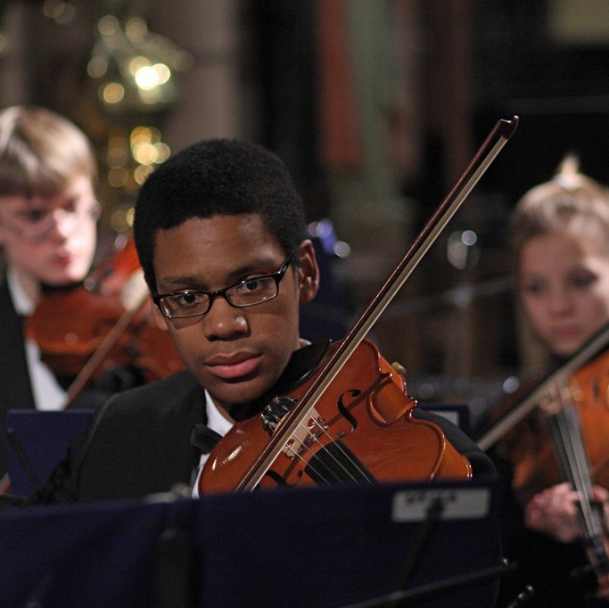
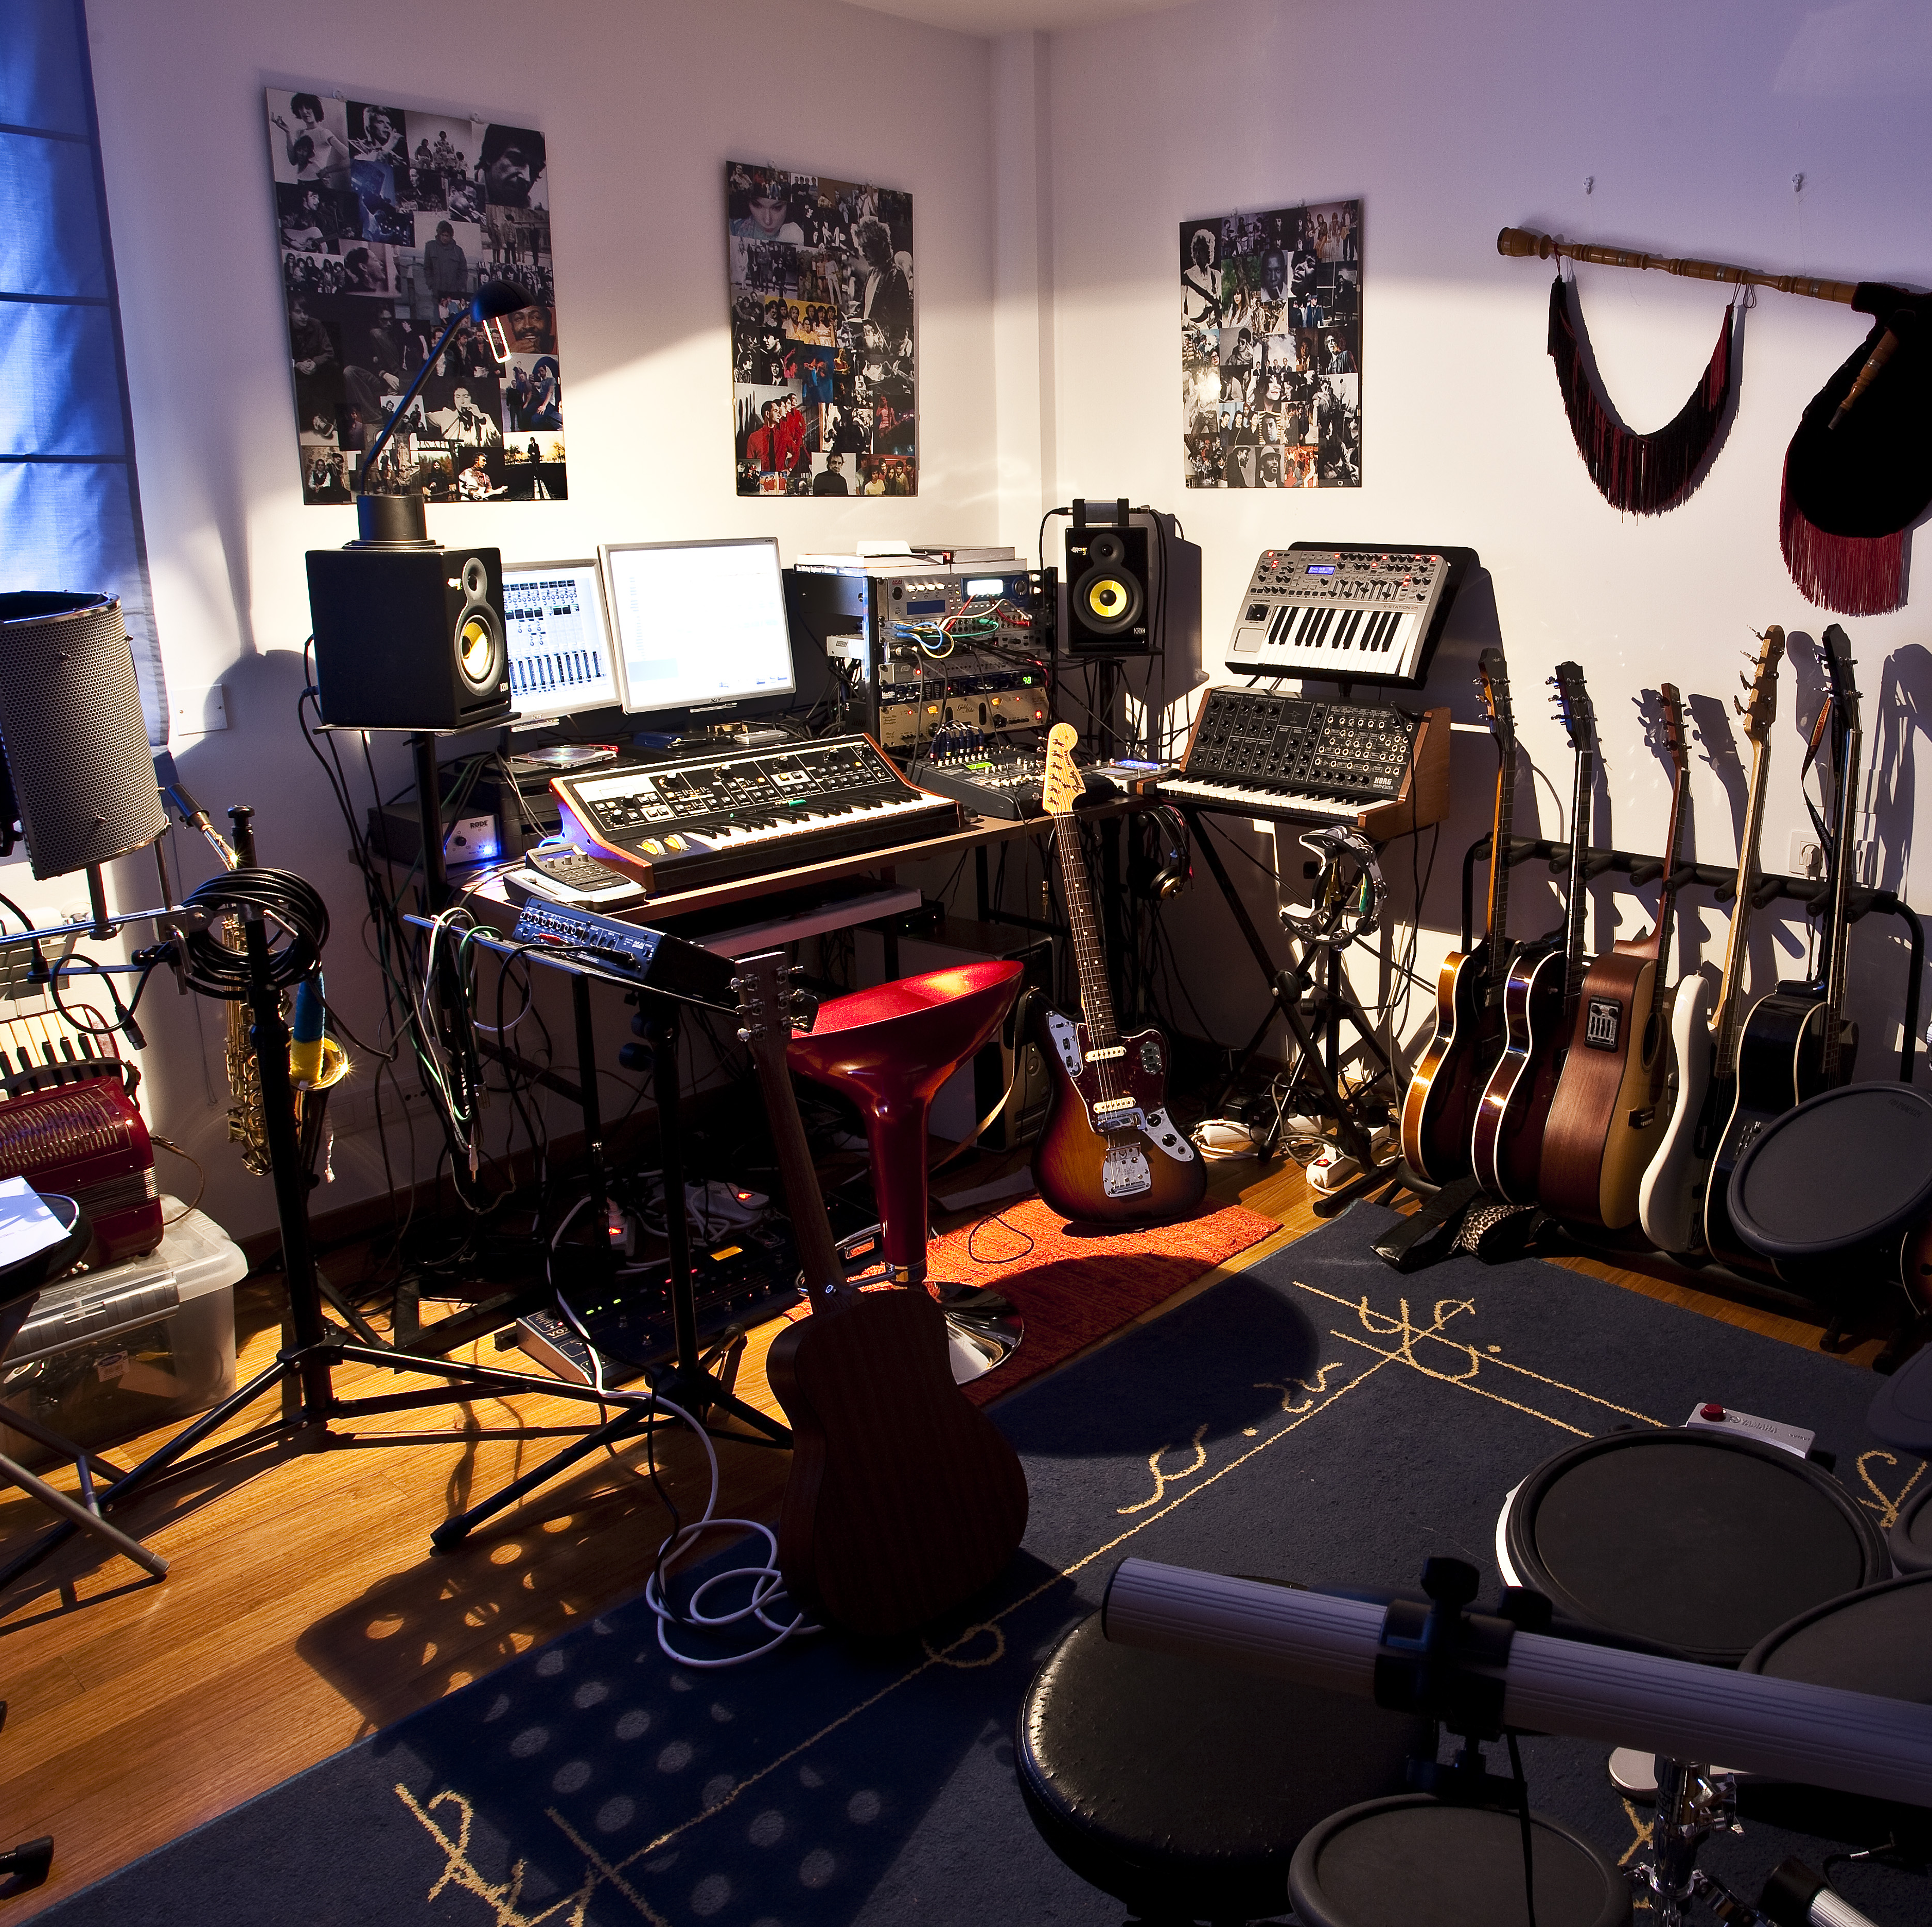
Further education in music
A degree in music is usually referred to as a Bachelor of Arts (BA) or a Bachelor of Music (BMus). Either option will offer a wide range of speciality to focus on. The main areas of study are usually divided into three main categories: composition, performance, musicology. In addition to a university degree there are many other music related courses available:
composition digital music live events production popular music performance media and communication (music industries) music business | music journalism music management music production music technology musical theatre | songwriting sound engineering sound technology stage management
Careers in music
While music jobs are undoubtedly competitive, they're by no means out of reach for those with the right qualifications and experience. Here are some of the music jobs you can do.
A&R (artists and repertoire) manager concert promoter music magazine journalist music producer background singer blogger booking agent | composer DJ event manager instrument technician live sound technician music PR music teacher | music therapist musical director musician radio producer recording engineer singer songwriter tour manage
This Photo by Unknown author is licensed under CC BY-SA.
This Photo by Unknown author is licensed under CC BY-SA.
This Photo by Unknown author is licensed under CC BY.

